Slide 1

Connect Four
connecting blocks on the blockchain

Slide 2
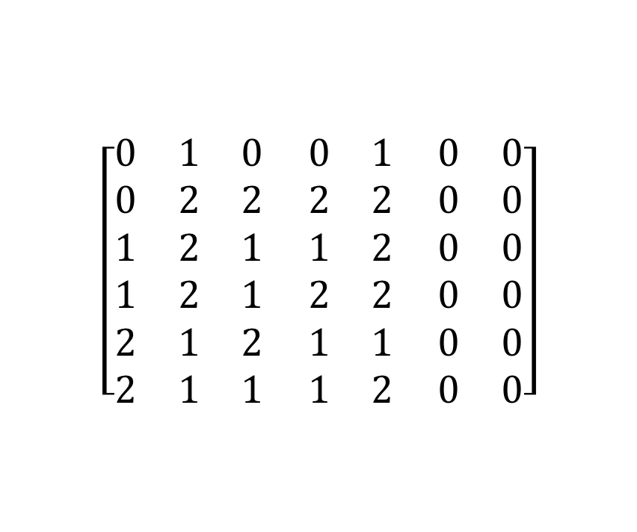
The Concept
Let’s create a simple turn-based game for 2 players.
Connect Four
Front-End necessary
Let them play for ETH and we take a cut.
Connect four is a solved game!
Restrictions
Incentives
$$\left[\begin{matrix}0 & 1 & 0 \\ 0 & 2 & 2 \\ 1 & 2 & 1 \\ 1 & 2 & 1 \\ 2 & 1 & 2 \\ 2 & 1 & 1\end{matrix} \begin{matrix}0 & 1 \\ 2 & 2 \\ 1 & 2 \\ 2 & 2 \\ 1 & 1 \\ 1 & 2\end{matrix} \begin{matrix}0 & 0 \\ 0 & 0 \\ 0 & 0 \\ 0 & 0 \\ 0 & 0 \\ 0 & 0\end{matrix}\right]$$

Slide 3
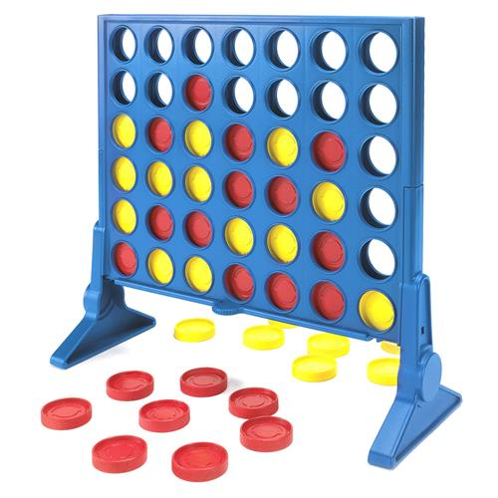
The Concept
Let’s create a simple turn-based game for 2 players.
Connect Four
Front-End necessary
Let them play for ETH and we take a cut.
Connect four is a solved game!
Restrictions
Incentives
$$\left[\begin{matrix}0 & 1 & 0 \\ 0 & 2 & 2 \\ 1 & 2 & 1 \\ 1 & 2 & 1 \\ 2 & 1 & 2 \\ 2 & 1 & 1\end{matrix} \begin{matrix}0 & 1 \\ 2 & 2 \\ 1 & 2 \\ 2 & 2 \\ 1 & 1 \\ 1 & 2\end{matrix} \begin{matrix}0 & 0 \\ 0 & 0 \\ 0 & 0 \\ 0 & 0 \\ 0 & 0 \\ 0 & 0\end{matrix}\right]$$

Slide 4
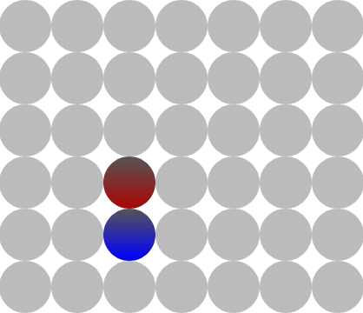
Adjustments
Solved game:
Modify the rules and make it harder!
Restrictions:
Bet can be 0.01 to 5.00 ETH
Incentives:
Incentive for losing player to give up

Slide 5
The Smart Contract
What the smart contract does:
Provides the rule set and enforces it
Checks for equal bets
Sets up the game (PRNG)
Most challenging function: has a player won the game?
Payout

Slide 6
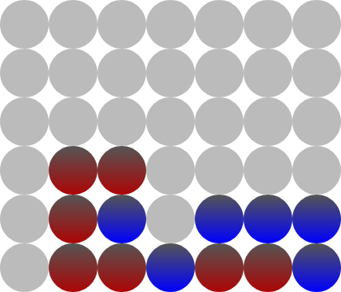
The Rules in General
Player 1 sets bet (0.01 – 5.00 ETH)
Player 2 matches the bet
Player 2 starts the game with another transaction (PRNG)
The game randomly assigns one stone per player and determines the starting player
Goal: connect 4 stones of your color in a row, column or diagonal
When the time per turn runs out, any party can end the game. The idle player loses!
Giving up gives the losing player a small amount of ETH
The winner takes it all! (Well, most of it…)
Notes:
Explain OUR rules
Possiblity to win (BLUE)
Special case: there may be 5 in a row! Make sure the contract allows this as well!

Slide 7
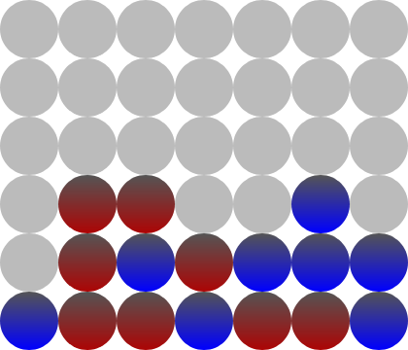
The Rules in General
Player 1 sets bet (0.01 – 5.00 ETH)
Player 2 matches the bet
Player 2 starts the game with another transaction (PRNG)
The game randomly assigns one stone per player and determines the starting player
Goal: connect 4 stones of your color in a row, column or diagonal
When the time per turn runs out, any party can end the game. The idle player loses!
Giving up gives the losing player a small amount of ETH
The winner takes it all! (Well, most of it…)
Notes:
Possibility to win (RED)
Special Case: player wins in two ways. Make sure the contract doesn’t do anything twice... (like a payout)

Slide 8
Pseudo-Random Number Generator
Don’t use block variables of a past block
Block variables of current block?
Block hash? …not possible
Others? …possible but not safe
Our solution:
Two-step approach

Slide 9

Pseudo-Random Number Generator
function rand() private returns (uint256) {
// use randomSeed as X_0
// X_(n+1) = a*X_n + c mod m
// a = 48271, c = 0, m = 2**32-1 (=4294967295)
currentRandomNumber = (48271 * currentRandomNumber) % 4294967295;
return currentRandomNumber;
}
function setUpGame() private {
currentRandomNumber = uint(player2JoinBlockHash ^ bytes32(uint256(startCoinbase) << 96));
//nextRandomNumber = rand() % n
$$x_{n+1}=(a × x_{n}+c) mod m$$

Slide 10
Function: checkVictoryCondition
function checkVictoryCondition(uint8 _col, uint8 _row) private {
(…)
// left side
currentStoneOwner = activePlayer;
currentCol = _col;
while (currentStoneOwner == activePlayer && currentCol >= 0) {
victoryPoints++;
if (currentCol > 0) {
currentCol--;
currentStoneOwner = grid[currentCol][_row];
} else
break;
}
(…)
Notes:
Function explanation:
New variable -> active player
If it’s player 1’s turn: set this variable to 1
Else: set variable to 2
We check horizontally, vertically and horizontally.
For time and space purposes we only look at one case:
New variable which is equal to active player
New variable which is equal to the chosen column (column in which the stone was placed)
While loop: we move from column to column for as long as the owner of the stone is the active player and the column number is at the highest 6. When all these criterias are met, we add one victory point
Having 4 (or more) victory points starts the playerWon function (not on this slide)
The SC does this horizontally (left, right), vertically (down) and diagonally (all directions).
QUESTION FROM MG: Wie versteht der SC, wenn wir einen Stein in der Mitte der Siegesstrasse legen?
zB: 011_10 -> 011110. sucht der contract jetzt nicht nur von _ aus nach rechts (und entdeckt 2 victorypoints?), verwirft das ganze, sucht wieder nach links (und entdeckt 3 victorypoints?)?

Slide 11
Let’s Play
on 4blocks.ch

